Slide 1
Module #16:
Probability Theory
26年 11月 8日
©2001-2004 Michael P. Frank, revised by S. Kang

Slide 2
Why Probability?
In the real world, we often don’t know whether a given proposition is true or false.
Probability theory gives us a way to reason about propositions whose truth is uncertain.
It is useful in weighing evidence, diagnosing problems, and analyzing situations whose exact details are unknown.
26年 11月 8日
©2001-2004 Michael P. Frank, revised by S. Kang

Slide 3
Random Variables
A “random variable” V is any variable whose value is unknown, or whose value depends on the precise situation.
  E.g., the number of students in the next class!!!
  Whether it will rain tonight (Boolean variable)
Let the domain of V be dom[V]≡{v₁,…,v_{n}}
  Infinite domains can also be dealt with if needed.
The proposition V=v_{i} may have an uncertain truth value, and may be assigned a probability.
26年 11月 8日
©2001-2004 Michael P. Frank, revised by S. Kang

Slide 4
Experiments & Sample Spaces
A (stochastic) experiment is any process by which a given random variable V gets assigned some particular value, and where this value is not necessarily known in advance.
  We call it the “actual” value of the variable, as determined by that particular experiment.
The sample space S of the experiment is just
the domain of the random variable, S = dom[V].
The outcome of the experiment is the specific value v_{i} of the random variable that is selected.
26年 11月 8日
©2001-2004 Michael P. Frank, revised by S. Kang

Slide 5
Events
An event E is any set of possible outcomes in S…
  That is, E ⊆ S = dom[V].
    E.g., the event that “less than 60 students show up for our next class” is represented as the set {1, 2, …, 49} of values of the variable V = (# of people here next class).
We say that event E occurs when the actual value of V is in E, which may be written V∈E.
  Note that V∈E denotes the proposition (of uncertain truth) asserting that the actual outcome (value of V) will be one of the outcomes in the set E.
26年 11月 8日
©2001-2004 Michael P. Frank, revised by S. Kang

Slide 6
Probability
The probability p = Pr[E] ∈ [0,1] of an event E is a real number representing our degree of certainty that E will occur.
  If Pr[E] = 1, then E is absolutely certain to occur,
    thus V∈E has the truth value True.
  If Pr[E] = 0, then E is absolutely certain not to occur,
    thus V∈E has the truth value False.
  If Pr[E] = ½, then we are maximally uncertain about whether E will occur; that is,
    V∈E and V∉E are considered equally likely.
  How do we interpret other values of p?
26年 11月 8日
©2001-2004 Michael P. Frank, revised by S. Kang

Slide 7
Four Definitions of Probability
Several alternative definitions of probability are commonly encountered:
  Frequentist, Bayesian, Laplacian, Axiomatic
They have different strengths & weaknesses, philosophically speaking.
  But fortunately, they coincide with each other and work well together, in the majority of cases that are typically encountered.
26年 11月 8日
©2001-2004 Michael P. Frank, revised by S. Kang

Slide 8
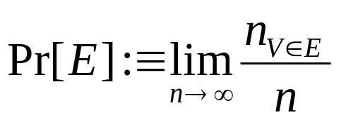
Probability: Frequentist Definition
The probability of an event E is the limit, as n→∞, of the fraction of times that we find V∈E over the course of n independent repetitions of (different instances of) the same experiment.
Some problems with this definition:
  It is only well-defined for experiments that can be independently repeated, infinitely many times!
  It can never be measured exactly in finite time!
Advantage: It’s an objective, mathematical definition.
26年 11月 8日
©2001-2004 Michael P. Frank, revised by S. Kang

Slide 9
Probability: Bayesian Definition
Suppose a rational, profit-maximizing entity R is offered a choice between two rewards:
  Winning $1 if and only if the event E actually occurs.
  Receiving p dollars (where p∈[0,1]) unconditionally.
If R can honestly state that he is completely indifferent between these two rewards, then we say that R’s probability for E is p, that is, Pr_{R}[E] :≡ p.
Problem: It’s a subjective definition; depends on the reasoner R, and his knowledge, beliefs, & rationality.
26年 11月 8日
©2001-2004 Michael P. Frank, revised by S. Kang

Slide 10
Probability: Laplacian Definition
First, assume that all individual outcomes in the sample space are equally likely to each other…
Then, the probability of any event E is given by,
Pr[E] = |E|/|S|. Very simple!
Problems: Still needs a definition for equally likely, and depends on the existence of some finite sample space S in which all outcomes in S are, in fact, equally likely.
26年 11月 8日
©2001-2004 Michael P. Frank, revised by S. Kang

Slide 11
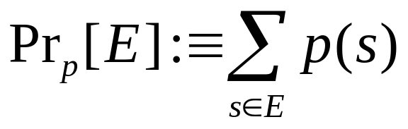
Probability: Axiomatic Definition
Let p be any total function p:S→[0,1] such that
∑_{s} p(s) = 1.
Such a p is called a probability distribution.
Then, the probability under p
of any event E⊆S is just:
Advantage: Totally mathematically well-defined!
  This definition can even be extended to apply to infinite sample spaces, by changing ∑→∫, and calling p a probability density function or a probability measure.
Problem: Leaves operational meaning unspecified.
26年 11月 8日
©2001-2004 Michael P. Frank, revised by S. Kang

Slide 12
Probabilities of Mutually
Complementary Events
Let E be an event in a sample space S.
Then, E represents the complementary event, saying that the actual value of V∉E.
Theorem: Pr[E] = 1 − Pr[E]
  This can be proved using the Laplacian definition of probability, since Pr[E] = |E|/|S| = (|S|−|E|)/|S| = 1 − |E|/|S| = 1 − Pr[E].
    Other definitions can also be used to prove it.
26年 11月 8日
©2001-2004 Michael P. Frank, revised by S. Kang

Slide 13
Probability vs. Odds
You may have heard the term “odds (승산)”
  It is widely used in the gambling community.
This is not the same thing as probability!
  But, it is very closely related.
The odds in favor of an event E means the relative probability of E compared with its complement E.
O(E) :≡ Pr(E)/Pr(E).
  E.g., if p(E) = 0.6 then p(E) = 0.4 and O(E) = 0.6/0.4 = 1.5.
Odds are conventionally written as a ratio of integers.
  E.g., 3/2 or 3:2 in above example. “Three to two in favor.”
The odds against E just means 1/O(E). “2 to 3 against”
26年 11月 8日
©2001-2004 Michael P. Frank, revised by S. Kang

Slide 14
Example 1: Balls-and-Urn
Suppose an urn contains 4 blue balls and 5 red balls.
An example experiment: Shake up the urn, reach in (without looking) and pull out a ball.
A random variable V: Identity of the chosen ball.
The sample space S: The set of
all possible values of V:
  In this case, S = {b₁,…,b₉}
An event E: “The ball chosen is
blue”: E = { ______________ }
What are the odds in favor of E?
What is the probability of E? (Use Laplacian def’n.)
b₁
b₂
b₉
b₇
b₃
b₅
b₄
b₈
b₆
26年 11月 8日
©2001-2004 Michael P. Frank, revised by S. Kang

Slide 15

Example 2: Seven on Two Dice
Experiment: Roll a pair of
fair (unweighted) 6-sided dice.
Describe a sample space for this
experiment that fits the Laplacian definition.
Using this sample space, represent an event E expressing that “the upper spots sum to 7.”
What is the probability of E?
26年 11月 8日
©2001-2004 Michael P. Frank, revised by S. Kang

Slide 16
Probability of Unions of Events
Let E₁,E₂ ⊆ S = dom[V].
Then we have: Theorem:
Pr[E₁∪ E₂] = Pr[E₁] + Pr[E₂] − Pr[E₁∩E₂]
  By the inclusion-exclusion principle, together with the Laplacian definition of probability.
You should be able to easily flesh out the proof yourself at home.
26年 11月 8日
©2001-2004 Michael P. Frank, revised by S. Kang

Slide 17
Mutually Exclusive Events
Two events E₁, E₂ are called mutually exclusive if they are disjoint: E₁∩E₂ = ∅
  Note that two mutually exclusive events cannot both occur in the same instance of a given experiment.
For mutually exclusive events,
Pr[E₁ ∪ E₂] = Pr[E₁] + Pr[E₂].
  Follows from the sum rule of combinatorics.
26年 11月 8日
©2001-2004 Michael P. Frank, revised by S. Kang

Slide 18

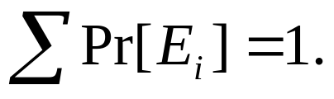
Exhaustive Sets of Events
A set E = {E₁, E₂, …} of events in the sample space S is called exhaustive iff .
An exhaustive set E of events, that are all mutually exclusive with each other, has the property that
You should be able to easily prove this theorem, using either the Laplacian or Axiomatic definitions of probability from earlier.
26年 11月 8日
©2001-2004 Michael P. Frank, revised by S. Kang

Slide 19
Independent Events
Two events E,F are called independent if
Pr[E∩F] = Pr[E]·Pr[F].
Relates to the product rule for the number of ways of doing two independent tasks.
Example: Flip a coin, and roll a die.
  Pr[(coin shows heads) ∩ (die shows 1)] =
  Pr[coin is heads] × Pr[die is 1] = ½×1/6 =1/12.
26年 11月 8日
©2001-2004 Michael P. Frank, revised by S. Kang

Slide 20
Conditional Probability
Let E,F be any events such that Pr[F]>0.
Then, the conditional probability of E given F, written Pr[E|F], is defined as
Pr[E|F] :≡ Pr[E∩F]/Pr[F].
This is what our probability that E would turn out to occur should be, if we are given only the information that F occurs.
If E and F are independent then Pr[E|F] = Pr[E].
   Pr[E|F] = Pr[E∩F]/Pr[F] = Pr[E]×Pr[F]/Pr[F] = Pr[E]
26年 11月 8日
©2001-2004 Michael P. Frank, revised by S. Kang

Slide 21
Prior and Posterior Probability
Suppose that, before you are given any information about the outcome of an experiment, your personal probability for an event E to occur is p(E) = Pr[E].
  The probability of E in your original probability distribution p is called the prior probability of E.
    This is its probability prior to obtaining any information about the outcome.
Now, suppose someone tells you that some event F (which may overlap with E) actually occurred in the experiment.
  Then, you should update your personal probability for event E to occur, to become p′(E) = Pr[E|F] = p(E∩F)/p(F).
    The conditional probability of E, given F.
  The probability of E in your new probability distribution p′ is called the posterior probability of E.
    This is its probability after learning that event F occurred.
After seeing F, the posterior distribution p′ is defined by letting
p′(v) = p({v}∩F)/p(F) for each individual outcome v∈S.
26年 11月 8日
©2001-2004 Michael P. Frank, revised by S. Kang

Slide 22
Visualizing Conditional Probability
If we are given that event F occurs, then
  Our attention gets restricted to the subspace F.
Our posterior probability for E (after seeing F) corresponds
to the fraction
of F where E
occurs also.
Thus, p′(E)=
p(E∩F)/p(F).
Entire sample space S
Event F
Event E
Event
E∩F
26年 11月 8日
©2001-2004 Michael P. Frank, revised by S. Kang

Slide 23
Conditional Probability Example
Suppose I choose a single letter out of the 26-letter English alphabet, totally at random.
  Use the Laplacian assumption on the sample space {a,b,..,z}.
  What is the (prior) probability
  that the letter is a vowel (모음)?
    Pr[Vowel] = __ / __ .
Now, suppose I tell you that the
letter chosen happened to be in
the first 9 letters of the alphabet.
  Now, what is the conditional (or
  posterior) probability that the letter
  is a vowel, given this information?
    Pr[Vowel | First9] = ___ / ___ .
1st 9
letters
vowels
z
w
k
r
b
c
a
t
y
u
d
f
x
e
s
o
i
g
l
h
p
n
j
v
q
m
Sample Space S
26年 11月 8日
©2001-2004 Michael P. Frank, revised by S. Kang

Slide 24
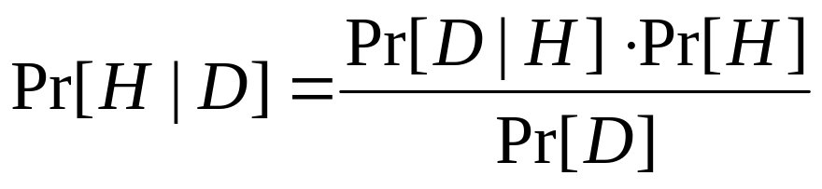
Bayes’ Rule
One way to compute the probability that a
hypothesis H is correct, given some data D:
This follows directly from the definition of
conditional probability! (Exercise: Prove it at home.)
This rule is the foundation of Bayesian methods for probabilistic reasoning, which are very powerful, and widely used in artificial intelligence applications:
  For data mining, automated diagnosis, pattern recognition, statistical modeling, even evaluating scientific hypotheses!
26年 11月 8日
©2001-2004 Michael P. Frank, revised by S. Kang

Slide 25
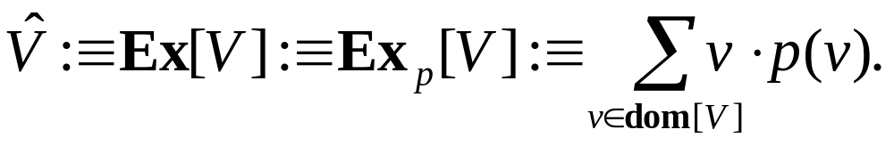
Expectation Values
For any random variable V having a numeric domain, its expectation value or expected value or weighted average value or (arithmetic) mean value Ex[V], under the probability distribution Pr[v] = p(v), is defined as
The term “expected value” is very widely used for this.
  But this term is somewhat misleading, since the “expected” value might itself be totally unexpected, or even impossible!
    E.g., if p(0)=0.5 & p(2)=0.5, then Ex[V]=1, even p(1)=0 and so we know that V≠1!
    Or, if p(0)=0.5 & p(1)=0.5, then Ex[V]=0.5 even if V is an integer variable!
26年 11月 8日
©2001-2004 Michael P. Frank, revised by S. Kang
Notes:
Discrete Mathematics and its Applications
(c)2001-2002, Michael P. Frank

Slide 26
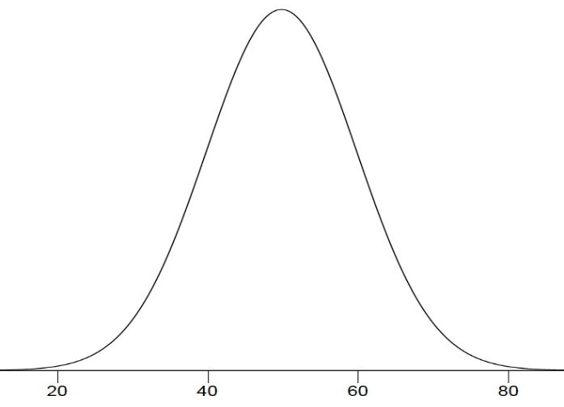
Mean versus Median
Which one represents a distribution better?
  Mean (Expected value) cannot be a representative value of other distributions than a normal distribution!
mean = median
f = 9,999
Pr(0) = 9,999/10,000
mean = 107,374
median = 0
f = 1
Pr(2³⁰)=1/10,000
0
2³⁰
26年 11月 8日
©2001-2004 Michael P. Frank, revised by S. Kang

Slide 27
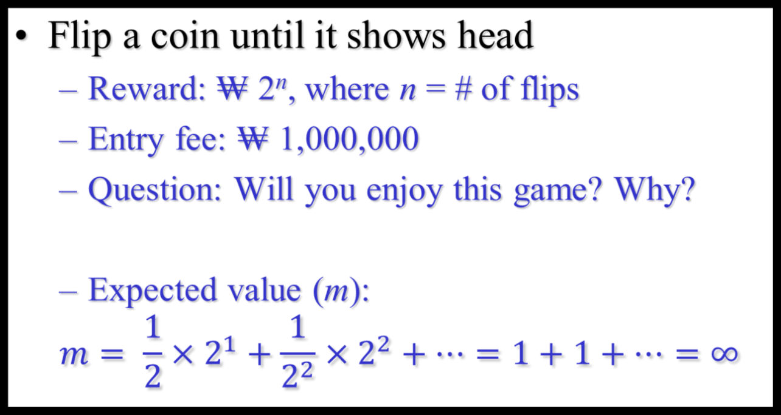
An Extremely Unfair Game
26年 11月 8日
©2001-2004 Michael P. Frank, revised by S. Kang

Slide 28
Analysis of the Unfair Game
Probability distribution (in terms of n)
  Pr(n) = 1/2^{n}
Reward distribution
  Re(n) = 2^{n}
No upper bound for n
  Even though there is an upper bound for n, any sufficiently large n can make the game looks unfair!
Pr(n)
Re(n)
n
26年 11月 8日
©2001-2004 Michael P. Frank, revised by S. Kang

Slide 29
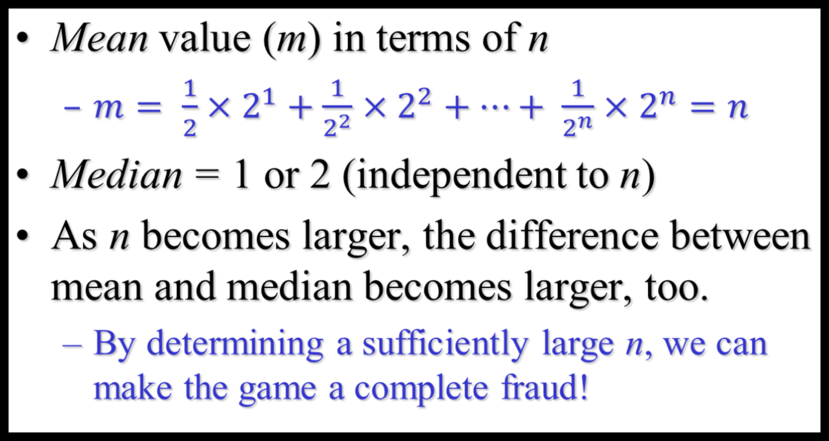
Analysis of the Unfair Game
26年 11月 8日
©2001-2004 Michael P. Frank, revised by S. Kang

Slide 30
Examples of the Fraud
Lotto
  Uses a very large n such that
    Pr (rank 1) < 1/8,000,000
    Re (rank 1) >> ₩ 8,000,000
Multilevel (Pyramid) marketing
  Hides the actually existing upper bound for n, which is generally very small, to make the mean value looks (very) large!
26年 11月 8日
©2001-2004 Michael P. Frank, revised by S. Kang

Slide 31
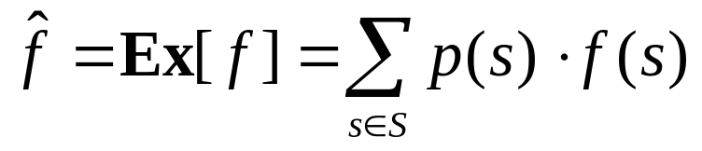
Derived Random Variables
Let S be a sample space over values of a random variable V (representing possible outcomes).
Then, any function f over S can also be considered to be a random variable (whose actual value f(V) is derived from the actual value of V).
If the range R = range[f] of f is numeric, then the mean value Ex[f] of f can still be defined, as
26年 11月 8日
©2001-2004 Michael P. Frank, revised by S. Kang

Slide 32
Linearity of Expectation Values
Let X₁, X₂ be any two random variables derived from the same sample space S, and subject to the same underlying distribution.
Then we have the following theorems:
  Ex[X₁+X₂] = Ex[X₁] + Ex[X₂]
  Ex[aX₁ + b] = aEx[X₁] + b
You should be able to easily prove these for yourself at home.
26年 11月 8日
©2001-2004 Michael P. Frank, revised by S. Kang

Slide 33
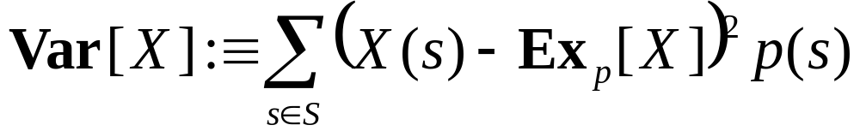
Variance & Standard Deviation
The variance Var[X] = σ²(X) of a random variable X is the expected value of the square of the difference between the value of X and its expectation value Ex[X]:
The standard deviation or root-mean-square (RMS) difference of X is σ(X) :≡ Var[X]^{1/2}.
26年 11月 8日
©2001-2004 Michael P. Frank, revised by S. Kang

